Slide 1
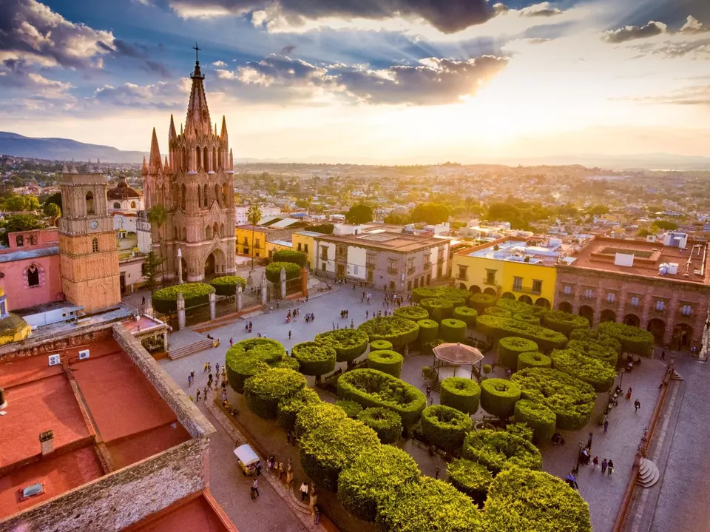
San miguel de allende

Slide 2
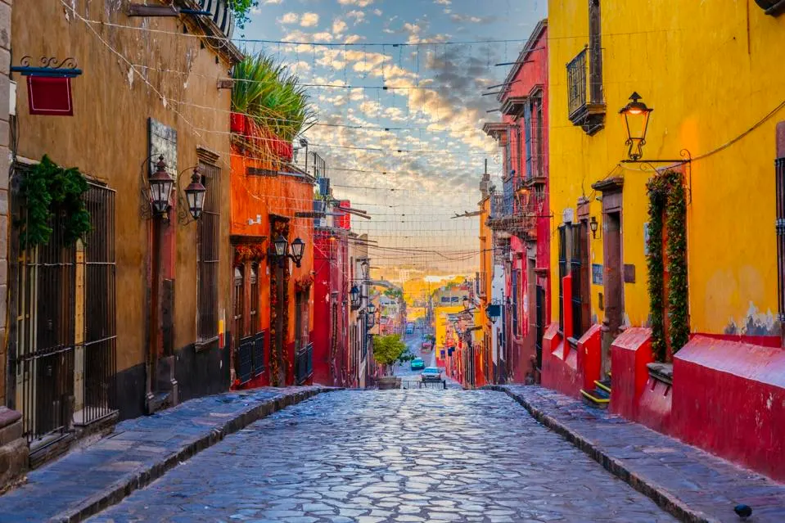

Slide 3
San Miguel de Allende – Health & Social Context
Overview for Planning Healthcare and Welfare Initiatives, Primarily Focused on Children.
Focus: population structure, vulnerable communities, Salud system, NGO:s inclusive churches activities such as orphanages and NGO like Patronato Pro Niños activities, and mobile clinic capacity.

Slide 4
General information San Miguel de Allende

Slide 5
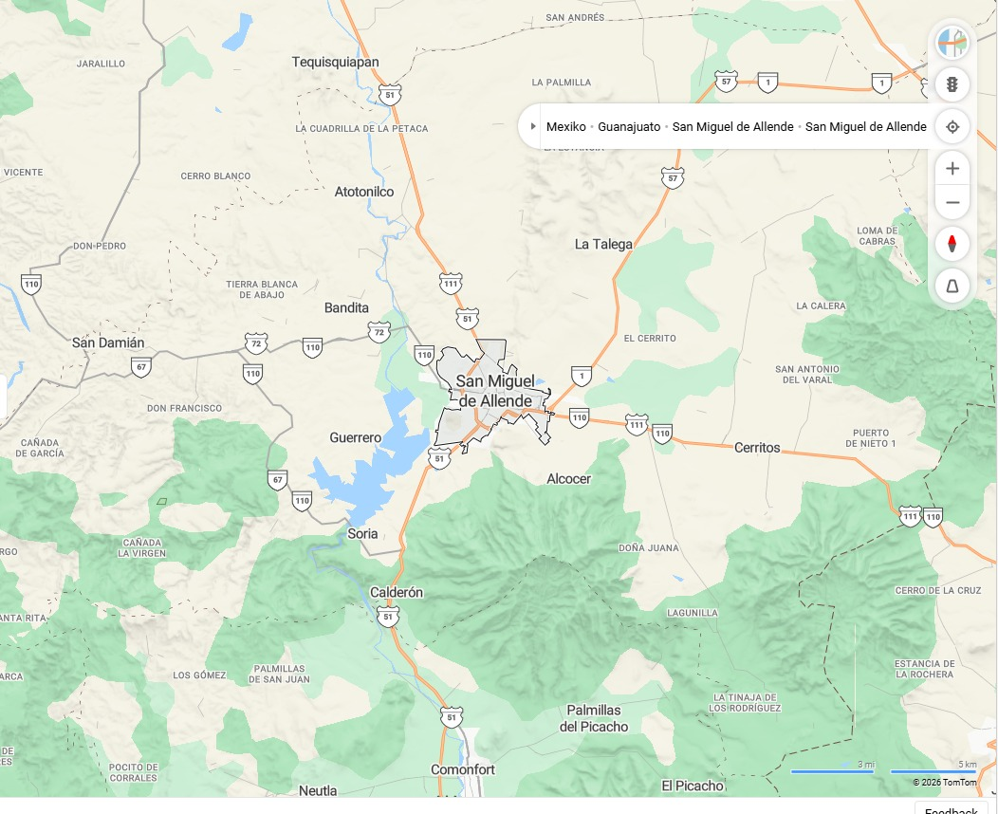



San Miguel urban (yellow) & RURAL mapp

Slide 6
Population Overview
Total municipality population: ~174,000
Urban population: ~70,000–80,000
Foreign residents: ~20,000–25,000
Estimated Americans: ~10,000–12,000
Mexican residents: ~150,000

Slide 7
Settlement Structure
More than 500 small communities in the municipality
Typical rural community: 200–1,000 residents
Larger villages: 1,000–2,500 residents
Peripheral urban colonias: 3,000–7,000 residents
Many peripheral areas have limited healthcare and social services

Slide 8
Examples of Vulnerable Areas
San Luis Rey
Palmita de Landeta
Allende
Infonavit Malanquín
Guadalupe
La Cieneguita
Los Rodríguez
La Aurora
San Miguel Viejo
Alcocer
Las Flores
Insurgentes
La Lejona
El Mirador outskirts
Monte Olivo
San Damián
La Palmita
Lindavista
San Antonio outskirts
San Rafael

Slide 9
Children in Vulnerable Conditions (Estimates)
Total children in municipality: ~40,000–50,000
Estimated children in vulnerable socioeconomic conditions: 10,000–20,000 i higher level och 10-15,000 moderate level
Common barriers: transport, medication costs, limited clinics

Slide 10
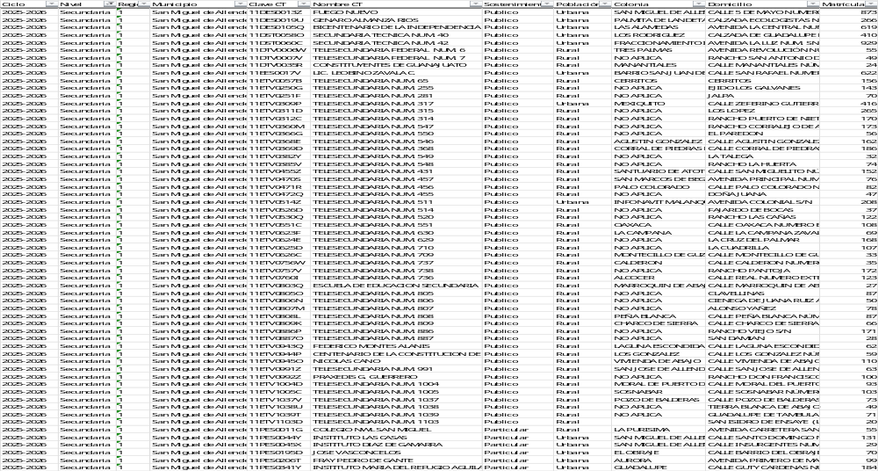
The list of schools i san miguel

Slide 11
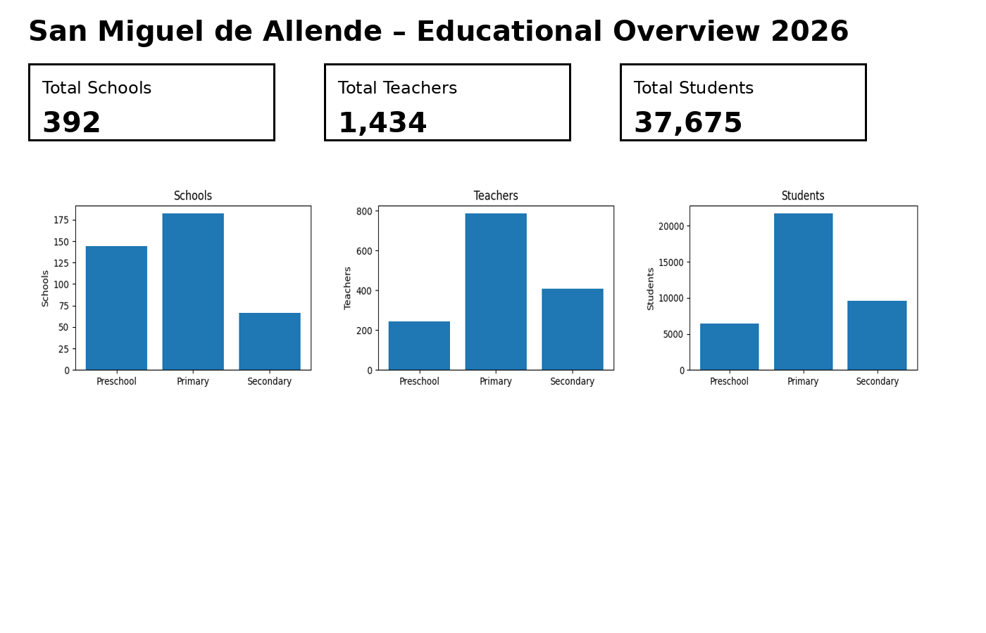
Schools statistic

Slide 12
School is compulsory in Mexico.
Mexican law states that education is compulsory:
• Preschool (preescolar)
• Primary school (primaria, 6 years)
• Lower secondary school (secundaria, 3 years)
• A minimum of 9 years of compulsory education in total
• Education in public schools is free
How many children attend school?
Almost all children start school.
The problem arises later.

Slide 13
How many children attend school?
Nationally in Mexico:
Almost all children start school.
Level | School attendance
Primary | ca 97–99 %
Lower secondary | ca 85–90 %
High school | ca 60–70 %

Slide 14
Schools in the Communities of San Miguel de Allende
San Miguel de Allende municipality has around 500 rural communities.
However, not every community has its own school.
Many small villages share schools located in nearby larger communities.

Slide 15
Typical Situation in Small Communities
Many communities have small populations (50–300 residents).
A full school is often not viable.
Therefore:
• Several communities share one school
• Students travel 10–30 minutes to reach school
• Primary school access is generally good, but higher grades may be farther away.

Slide 16
Types of Schools Serving Rural Communities
1. Public Primary Schools (Primaria)
• Located in larger villages
• Serve children from several nearby communities
2. CONAFE Community Schools
• Designed for very small villages
• Often one teacher for multiple grades
3. Shared Access
• Children travel to neighboring communities to attend school

Slide 17
Geographic Barriers
• Over 500 rural communities in the municipality
• Long travel distances to scholls &clinics
• Limited public transportation
• Travel time can be 1–2 hours for a part of rural residents

Slide 18
Why Many Residents Do Not Fully Benefit from Public Health & Social Services in San Miguel de Allende
Overview of structural, geographic, economic, and administrative barriers affecting access to care.

Slide 19
Capacity Limitations
• Public clinics can be overcrowded
• Limited appointment slots
• Reduced follow‑up care
• Preventive care often deprioritized

Slide 20
Limited Healthcare Infrastructure
• Some clinics open only a few days per week, unorganized appointment and lack of effective medical records
• Limited number of doctors and specialists or accumulation av doctor and nurses with limited output
• Long waiting times for appointments with referral ,unnecessarily referring for basic problems and even no referring for severe problem
• Limited diagnostic equipment in rural clinics but even in urban clinics

Slide 21
Administrative and Insurance Barriers
• Multiple healthcare systems (IMSS, ISSSTE, IMSS‑Bienestar)
• Many residents work in informal economy
• Some lack registration or documentation
• Access to services can depend on system eligibility

Slide 22
Economic Constraints
• Consultations may be free but other costs remain
• Patients often have to pay for medications if this is considered the appropriate choice.
• Laboratory tests and imaging studies may also require payment if they need to be performed within a short timeframe.
• Transportation costs create additional barriers

Slide 23
Limited Preventive Care Programs
• Lack of routine screenings
• Limited dental care access
• Mental health services scarce
• Health education programs unevenly distributed

Slide 24
Why Schools Are Important for Health Programs
Schools are key locations for reaching children in rural areas.
Health programs often operate through schools because:
• Most children attend school
• Many communities are covered by one school
• Easier logistics for mobile health teams
Typical activities:
• Dental screening
• Vaccination programs
• Health education

Slide 25
Social and Cultural Factors
• Limited health literacy in some communities
• Language barriers in rural populations
• Work schedules preventing clinic visits
• Distrust of institutions in some communities

Slide 26
Mexico Public Health Insurance Systems – Overview
Three main public systems provide healthcare access in Mexico:
• IMSS – for private sector employees
• ISSSTE – for government employees
• IMSS-Bienestar – for people without formal employment, uninsured population, low‑income and rural residents
Each system differs in funding, access, and practical service availability.

Slide 27
What Services Are Covered
IMSS:
• Primary care,• Specialist care
• Hospitalization and surgery,• Maternity care,• Some medications
ISSSTE:
• Similar coverage to IMSS, • Primary care and hospital care
• Maternity services • Medications (if available)
IMSS-Bienestar:
• Basic primary care,• Some hospital services
• Preventive programs, • Limited medications

Slide 28

Main Public Health Insurance Systems in Mexico
IMSS – Instituto Mexicano del Seguro Social
• Covers employees in the formal private sector
• Funded through employer and employee contributions
• Provides primary care, hospital care, maternity care, and pensions
ISSSTE – Instituto de Seguridad y Servicios Sociales de los Trabajadores del Estado
• Covers government employees (federal and public sector workers)
• Similar benefits to IMSS but within a separate system
• Includes healthcare, pensions, and social benefits
IMSS-Bienestar
• Public system intended for people without formal employment or insurance
• Provides free primary and hospital care in public facilities
• Focuses on low‑income populations and rural areas

Slide 29
Practical Differences in Access and Quality
IMSS:
• Large system
• Long waiting times
• Overcrowded clinics
ISSSTE:
• Smaller population
• Often shorter waiting times
IMSS-Bienestar:
• Designed for vulnerable populations
• Often limited equipment and staff
• More common in rural areas

Slide 30
Cost to Patients
IMSS:
• No payment at visit
• Funded via payroll contributions
ISSSTE:
• No payment at visit
• Funded through government payroll system
IMSS-Bienestar:
• Free for uninsured patients
• Government funded

Slide 31
Health System
Strategic overview of healthcare access, infrastructure,
diagnostics,
medicines,
and NGO opportunities

Slide 32
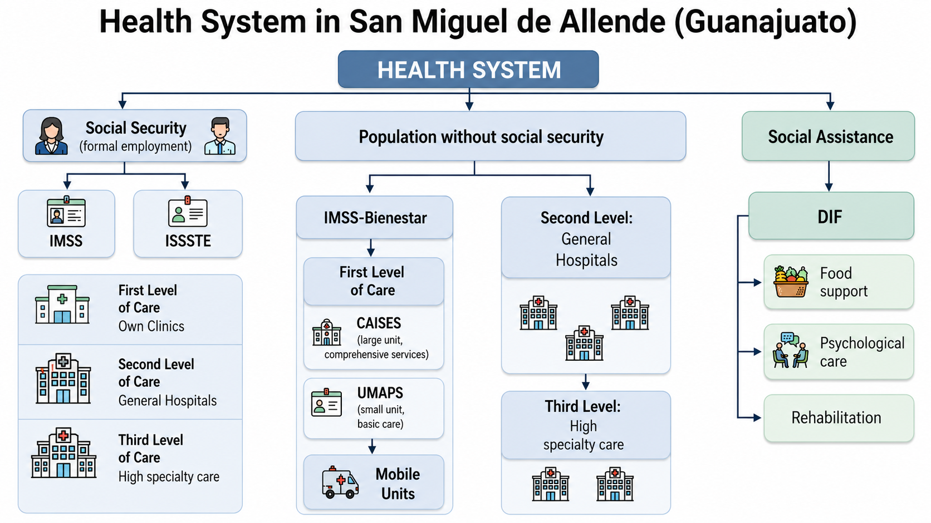

Slide 33
Geographic Access Problem
Municipality ~60–70 km across
Travel time to central clinic: 45–90 min by car
Without car: often 1–2 hours

Slide 34
San Miguel urban mapp

Slide 35
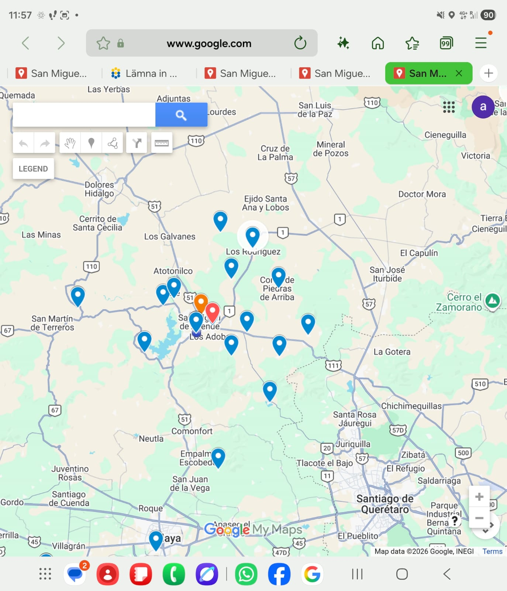

Caises and 15 Umaps

Slide 36
Healthcare System Structure
Public services mainly by Secretaría de Salud and IMSS
1 CAISES primary care center
15 UMAPS rural clinics
1 public hospital

Slide 37
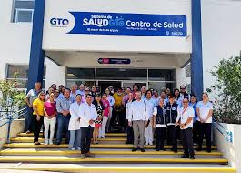
CAISES san Miguel

Slide 38
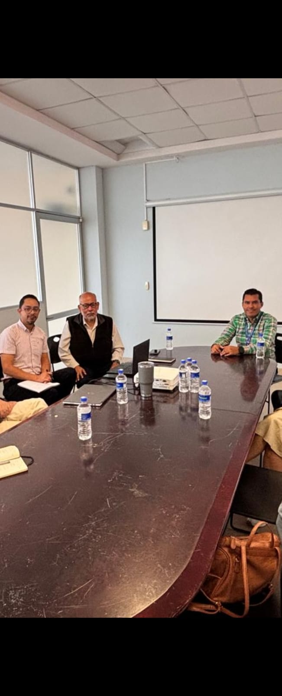
Primary care managers
Guanajuato (State Level): Dr. Jorge san miguel (regional level): Dr. Hector,DR Daniel

Slide 39
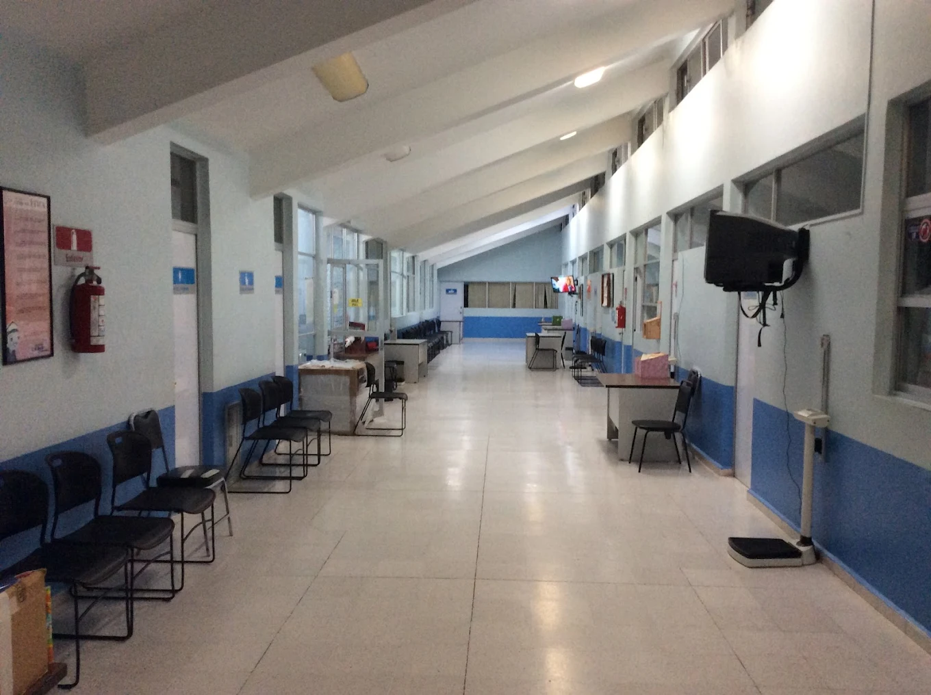
Caises inside

Slide 40
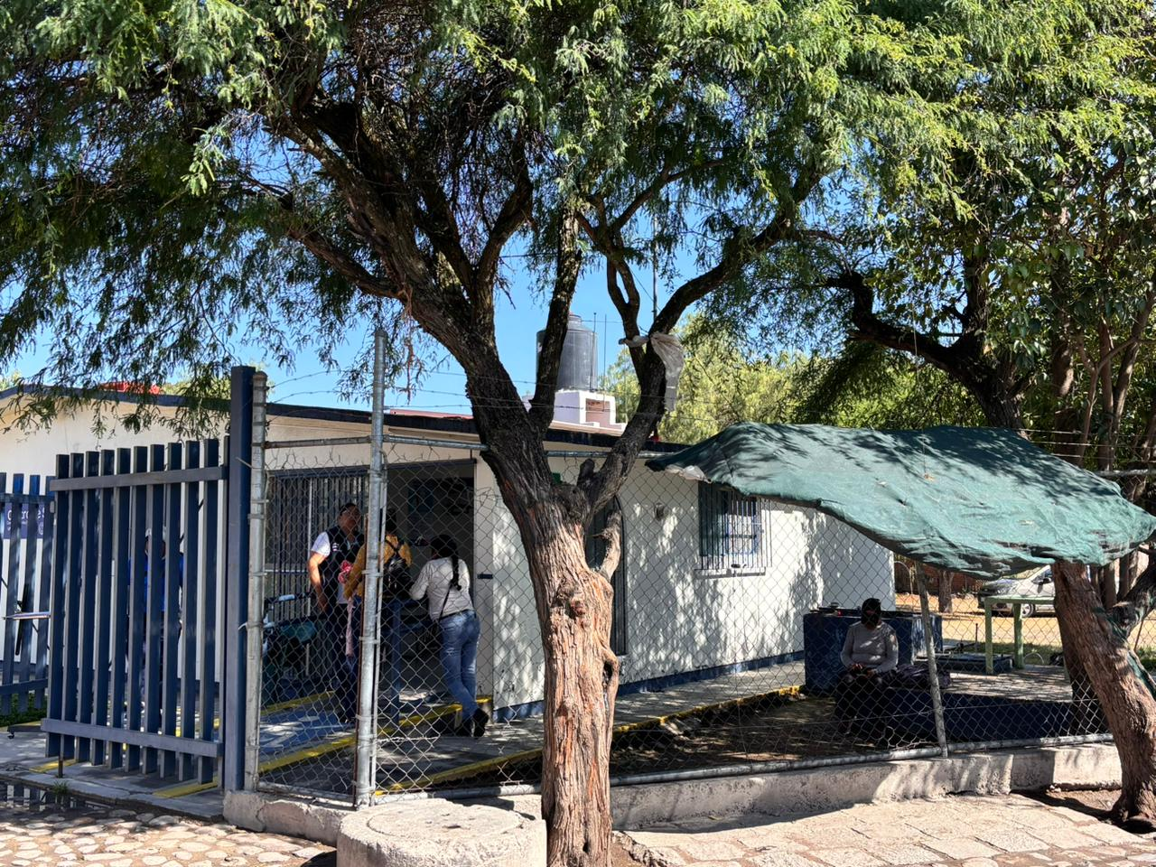
Umaps corralejo

Slide 41
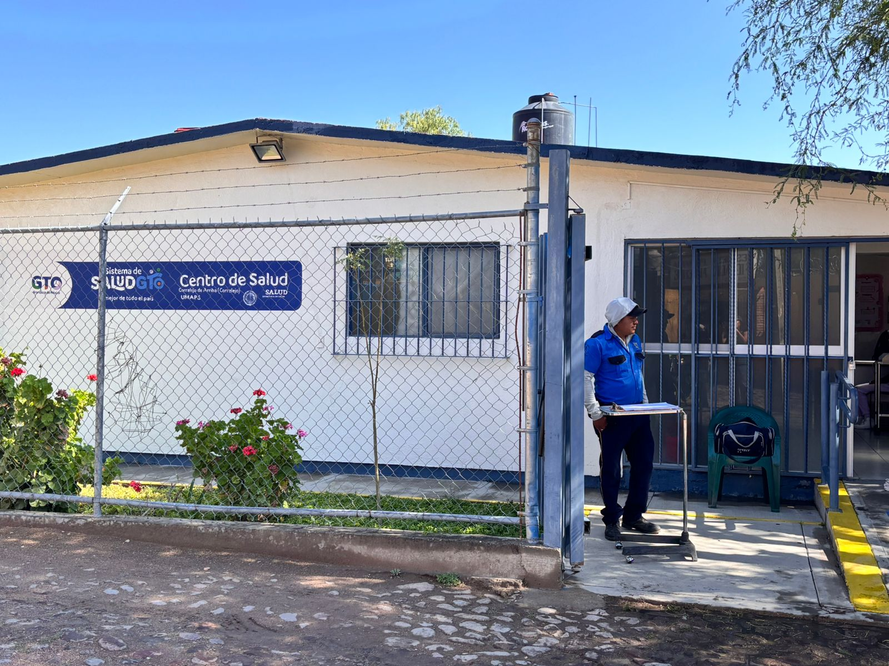
Umaps corralejo

Slide 42
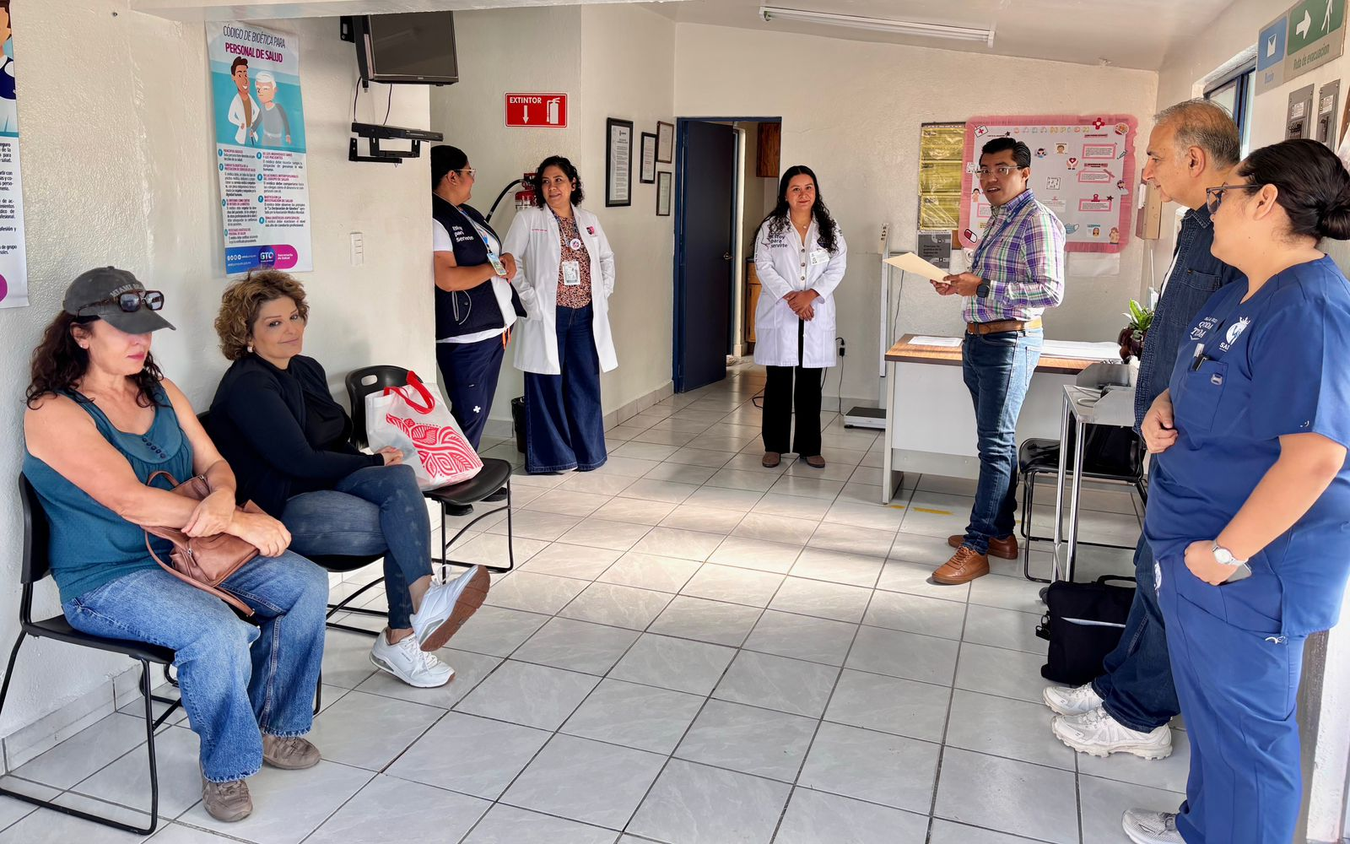
Umaps corralejo

Slide 43
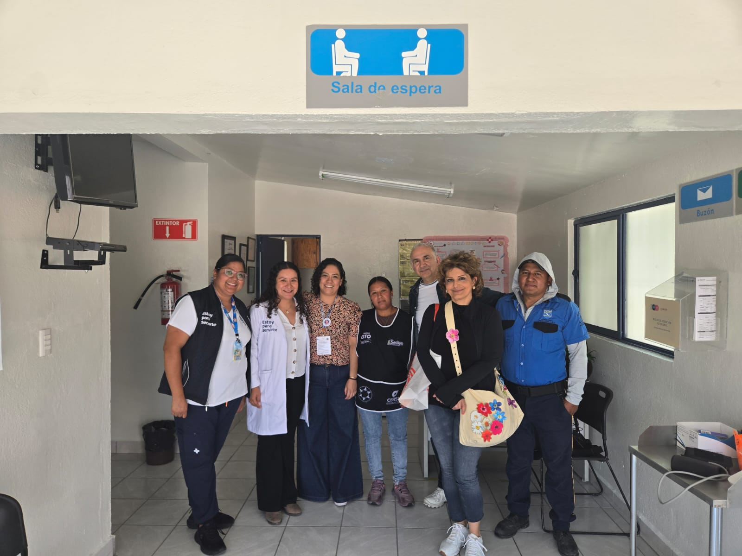
Umaps corralejo

Slide 44
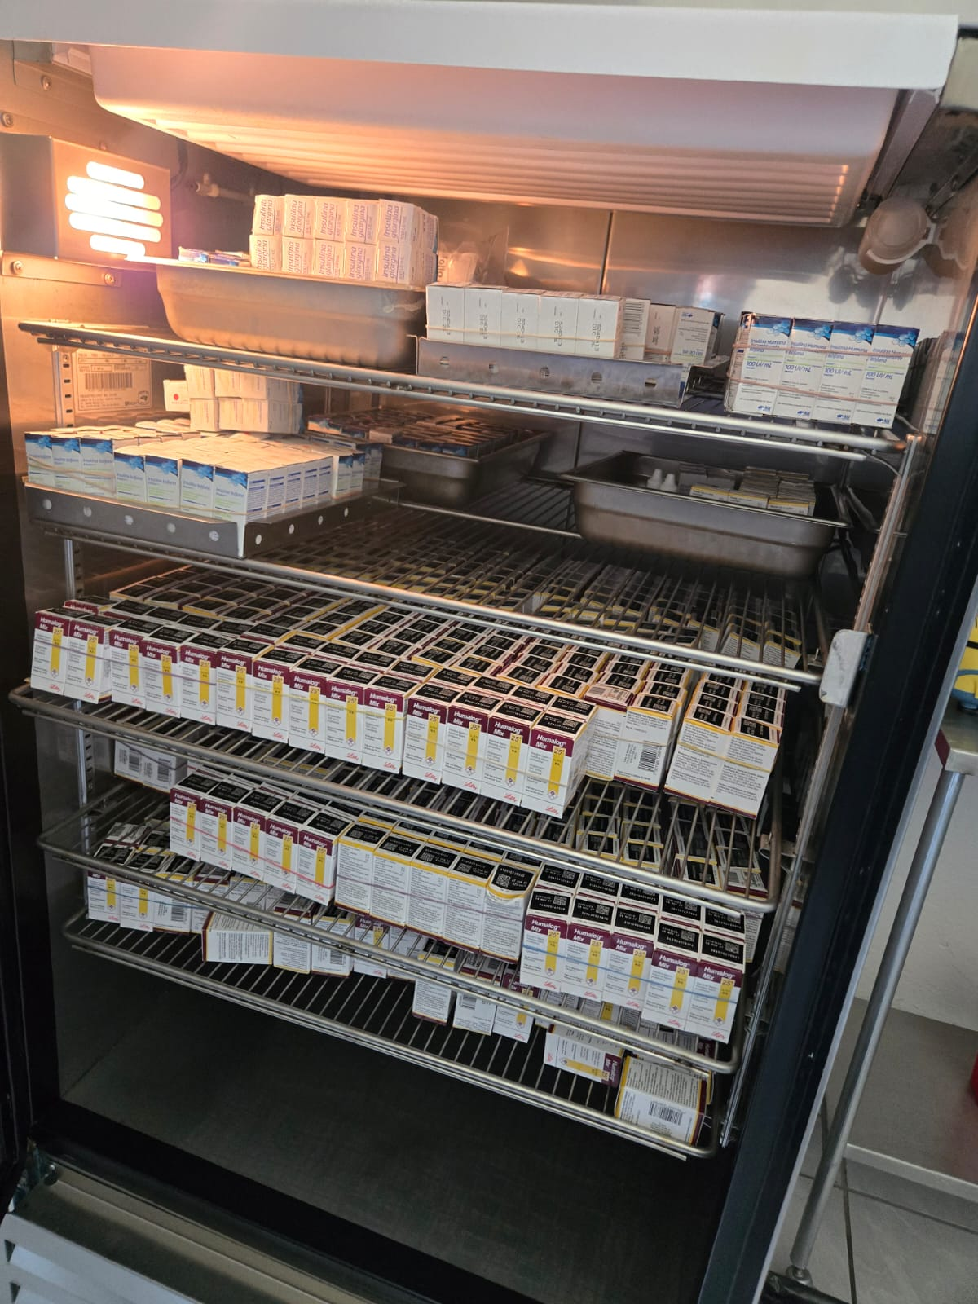
Umaps corralejo, medicin

Slide 45
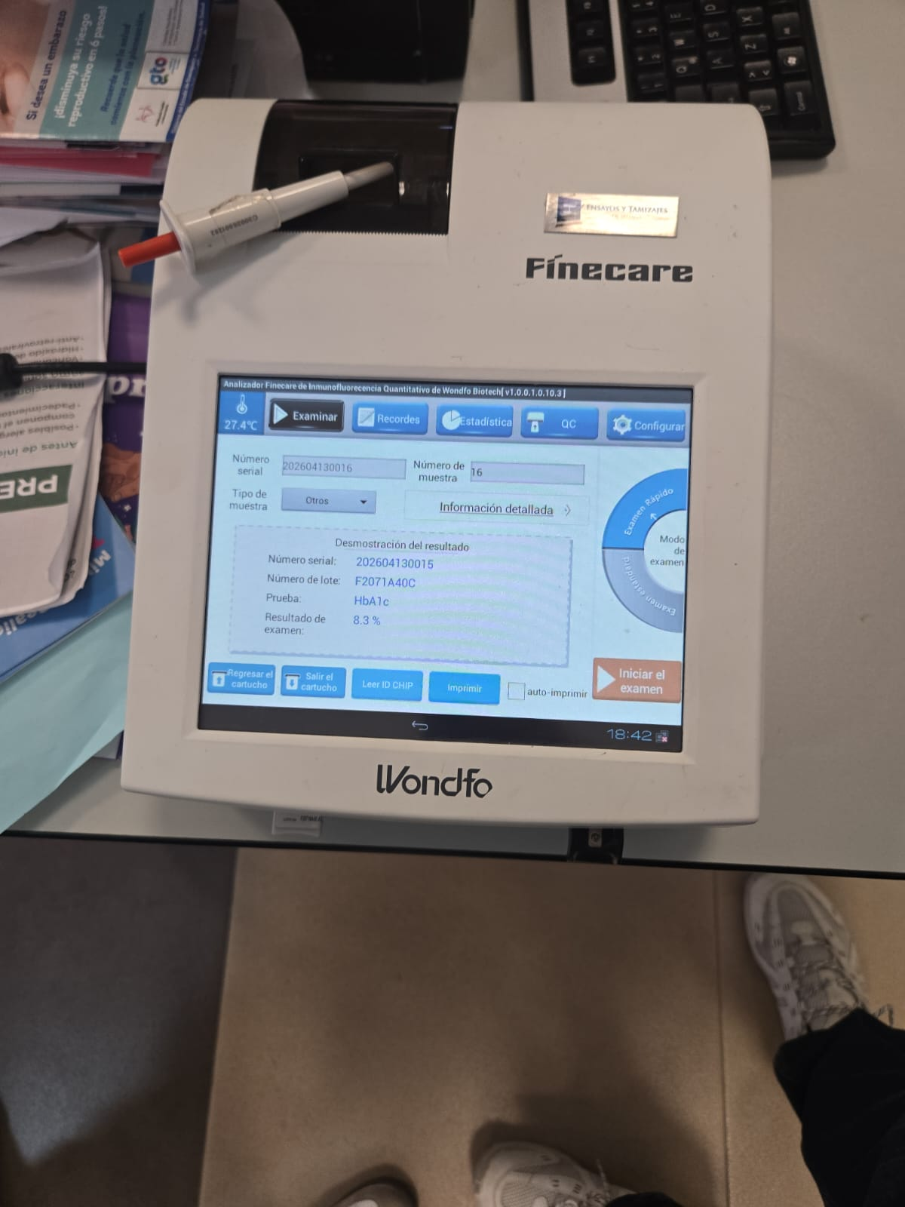
Umaps corralejo
Local lab instrument

Slide 46
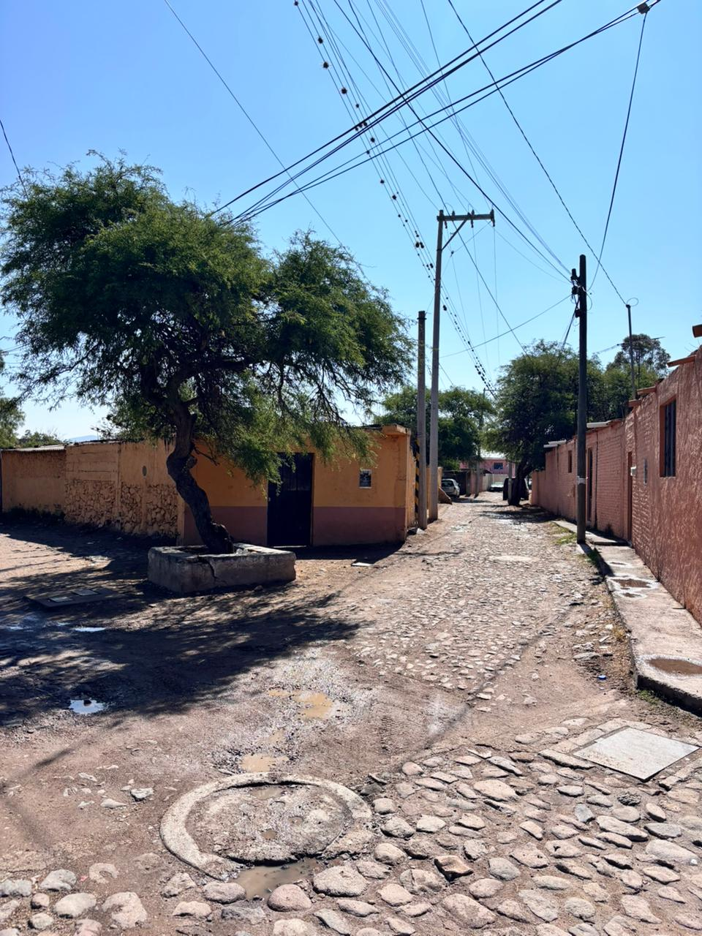
Umaps corralejo
Neigborhood

Slide 47
Healthcare Budget Structure
Guanajuato vs San Miguel de Allende

Slide 48
System Overview
Guanajuato (State Level):
- Total healthcare budget: ~15.6 billion MXN/year
- Primary care: ~20–30% (≈ 3–5 billion MXN)
- Hospital & specialist care: ~60–70%
San Miguel de Allende (Regional Level):
- Primary care budget: ~90–100 million MXN/year
- Covers CAISES + UMAPS (frontline care only)
- Hospital care funded separately

Slide 49
Primary Care Budget Breakdown – San Miguel (~100M MXN)
Human resources: 60–70% (60–70M)
Medications: 10–20% (10–20M)
Lab & Radiology: 5–10% (5–10M)
Operations: 10–15% (10–15M)
Transport & outreach: 3–5% (3–5M)
Administration: 3–5% (3–5M)

Slide 50
Key Structural Insight
- ~70% of budget locked in personnel
- Limited flexibility for diagnostics, IT, development
Primary care is resource-constrained but structurally functional

Slide 51
NGO
Patronato Pro Niños
SANTUARIO CASA HOGAR

Slide 52
Patronato Pro Niños – Organizational Programs
Dental program
Medical consultations
Psychological services
Social work
Preventive education

Slide 53
Mobile Units
1 stationary & 5 mobile medical/dental units
Travel distance: more than 40,000 km annually
Units visit schools and rural communities throughout the municipality

Slide 54
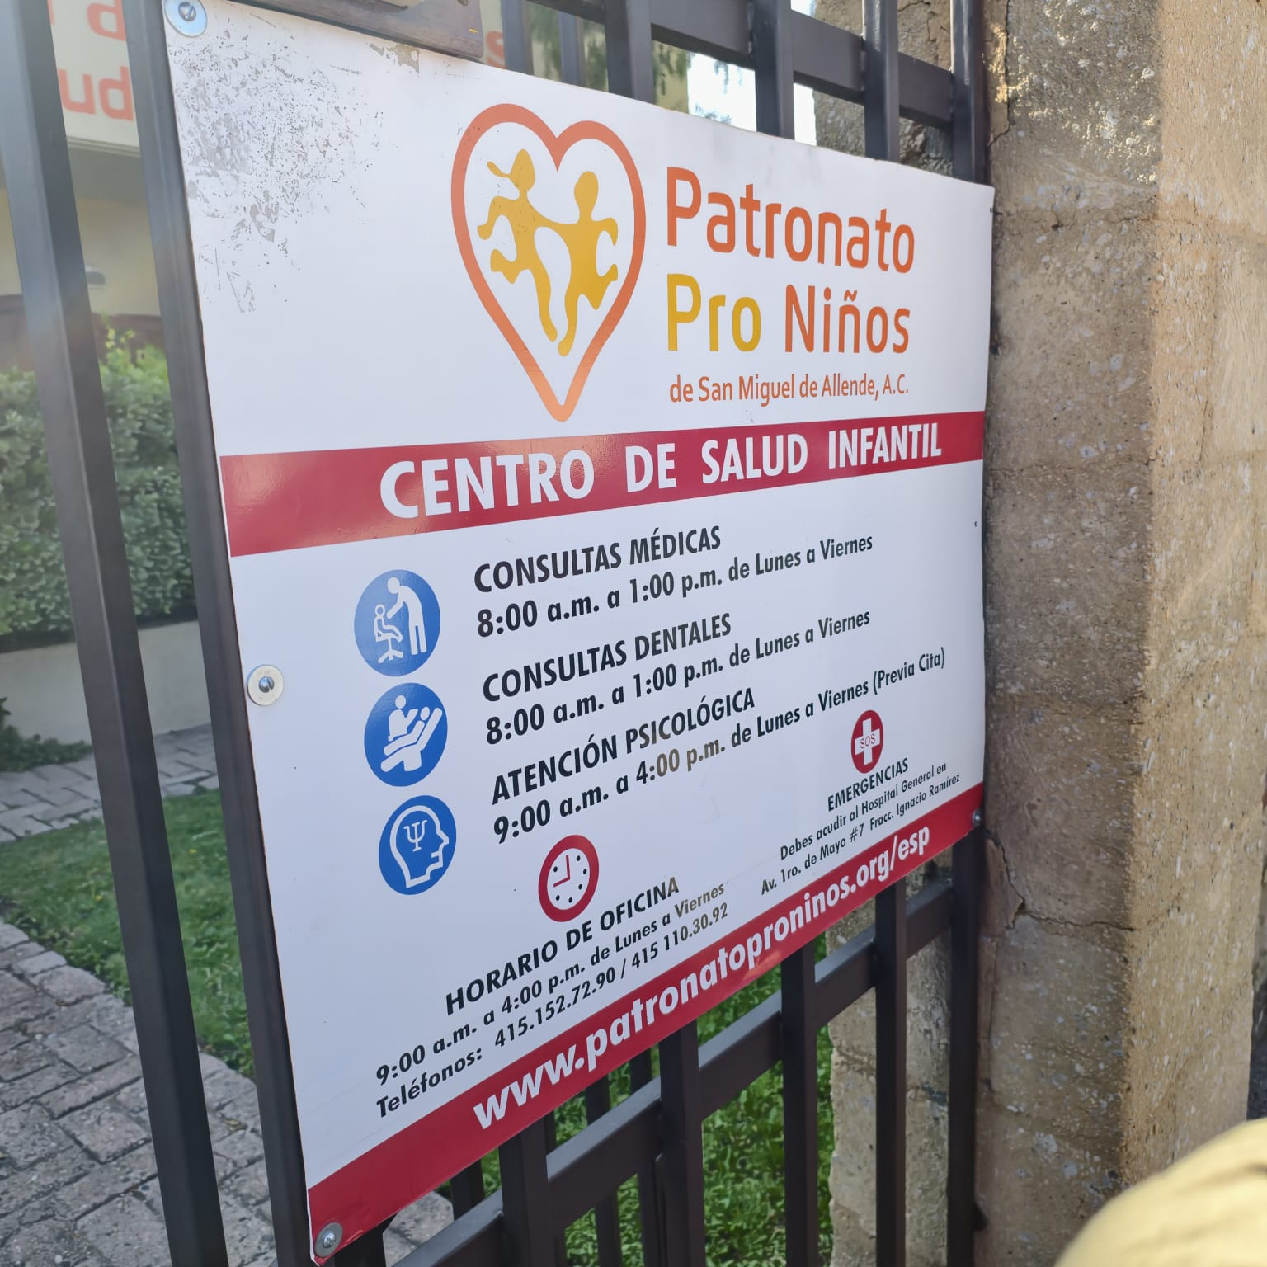
Patronato center

Slide 55
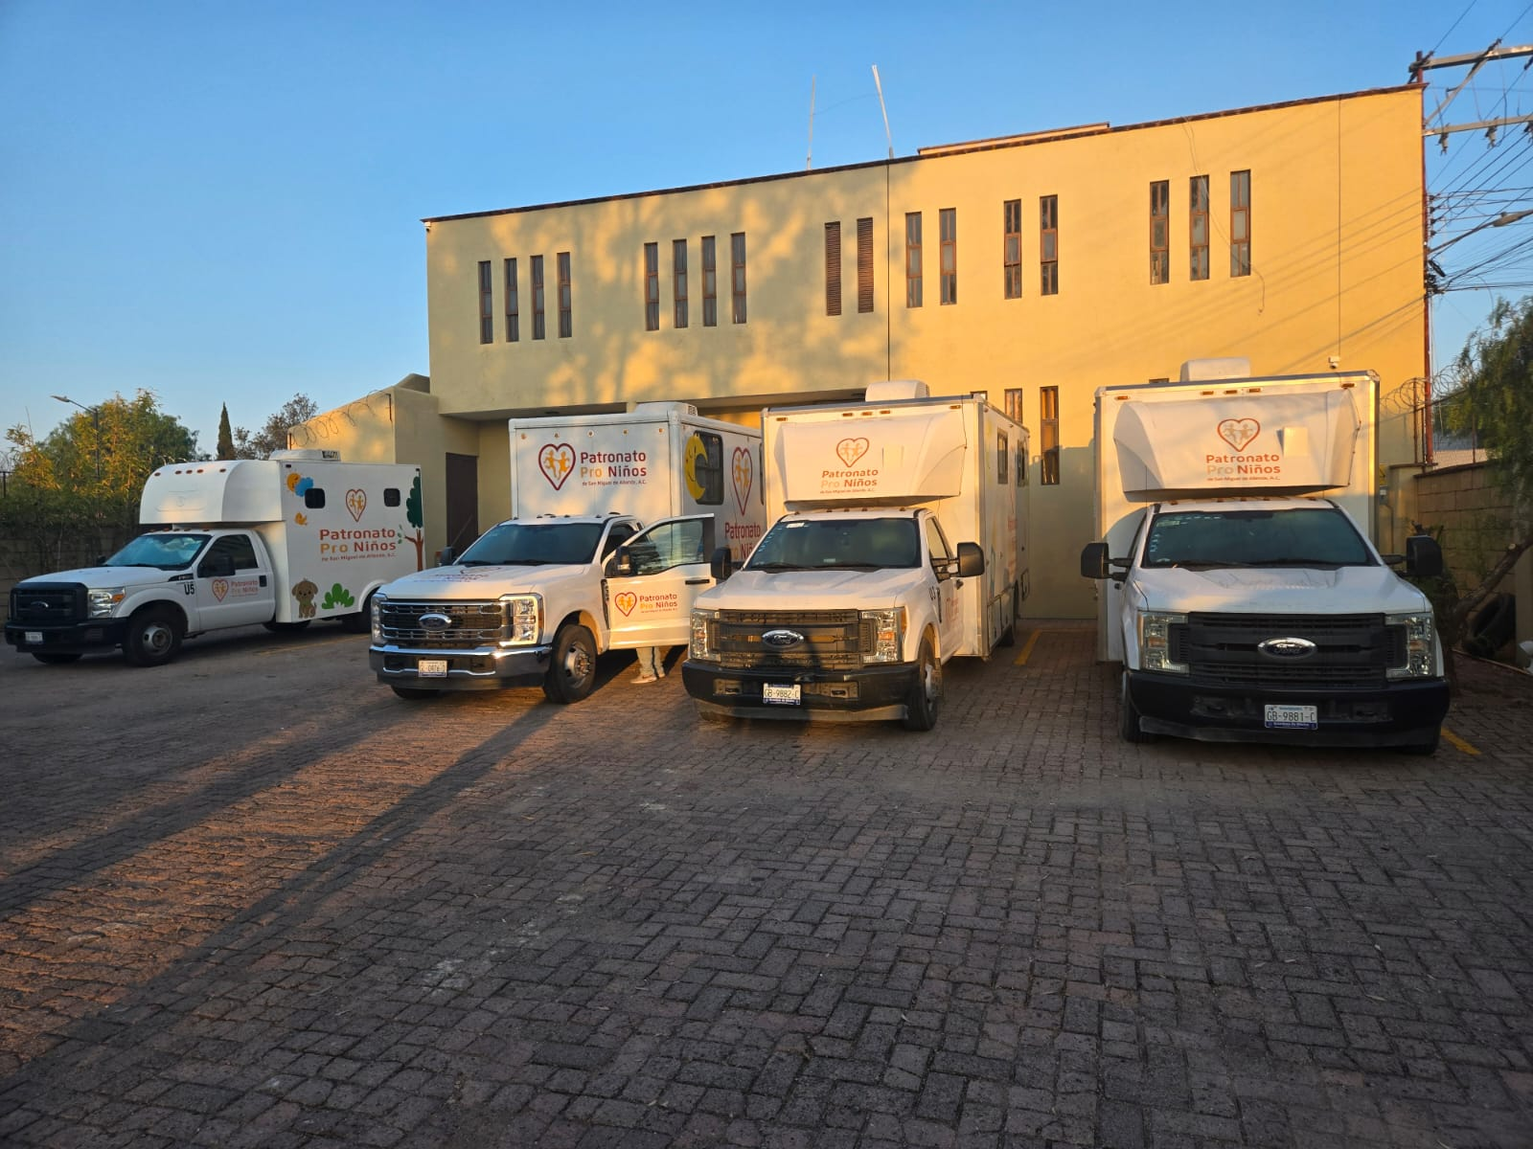
Patronatos mobile units

Slide 56
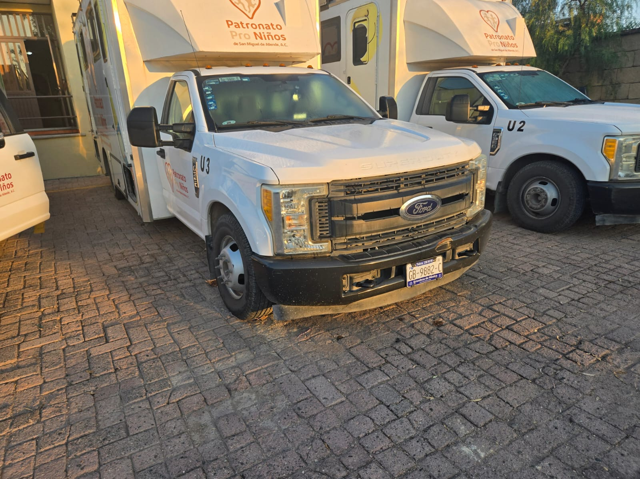
Mobile units

Slide 57
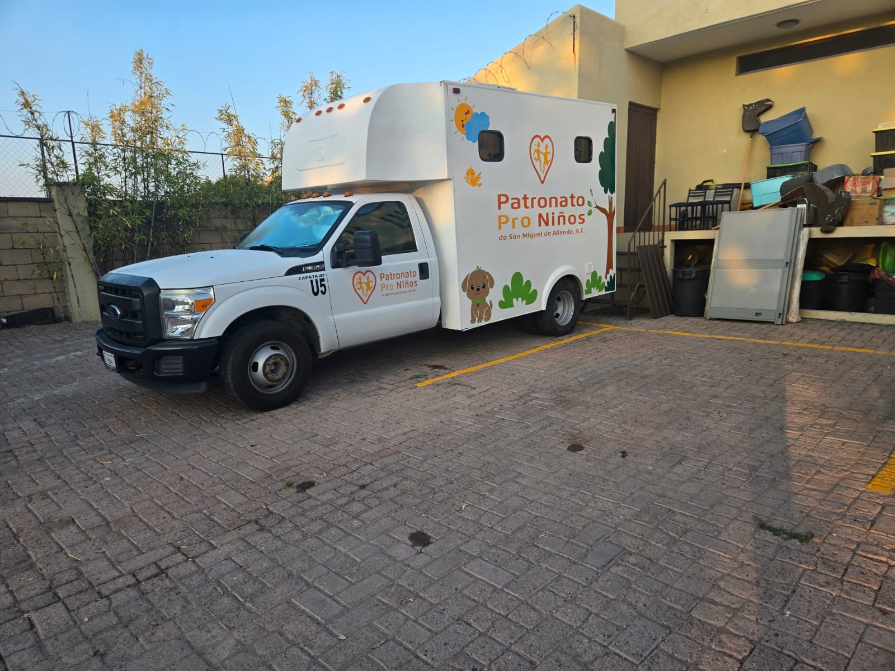
Mobile unit

Slide 58
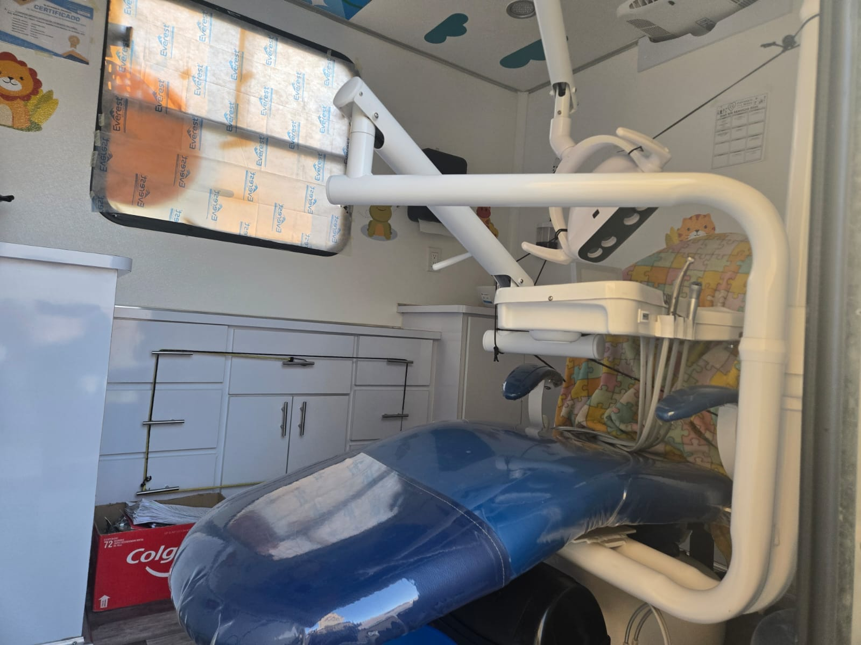
Inside of dental unit

Slide 59
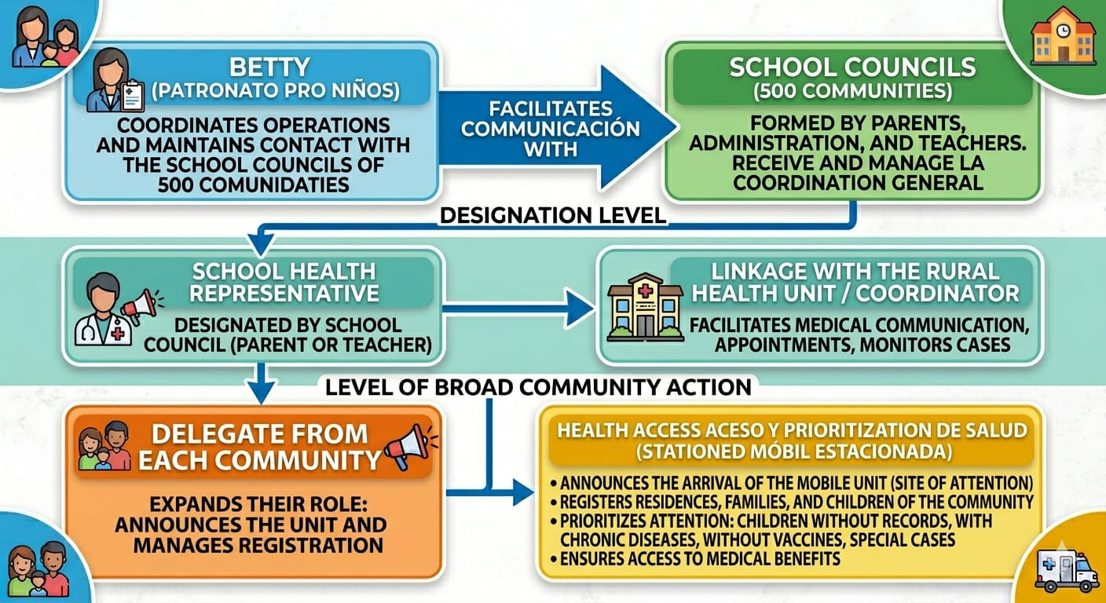
Preparation prior visit

Slide 60
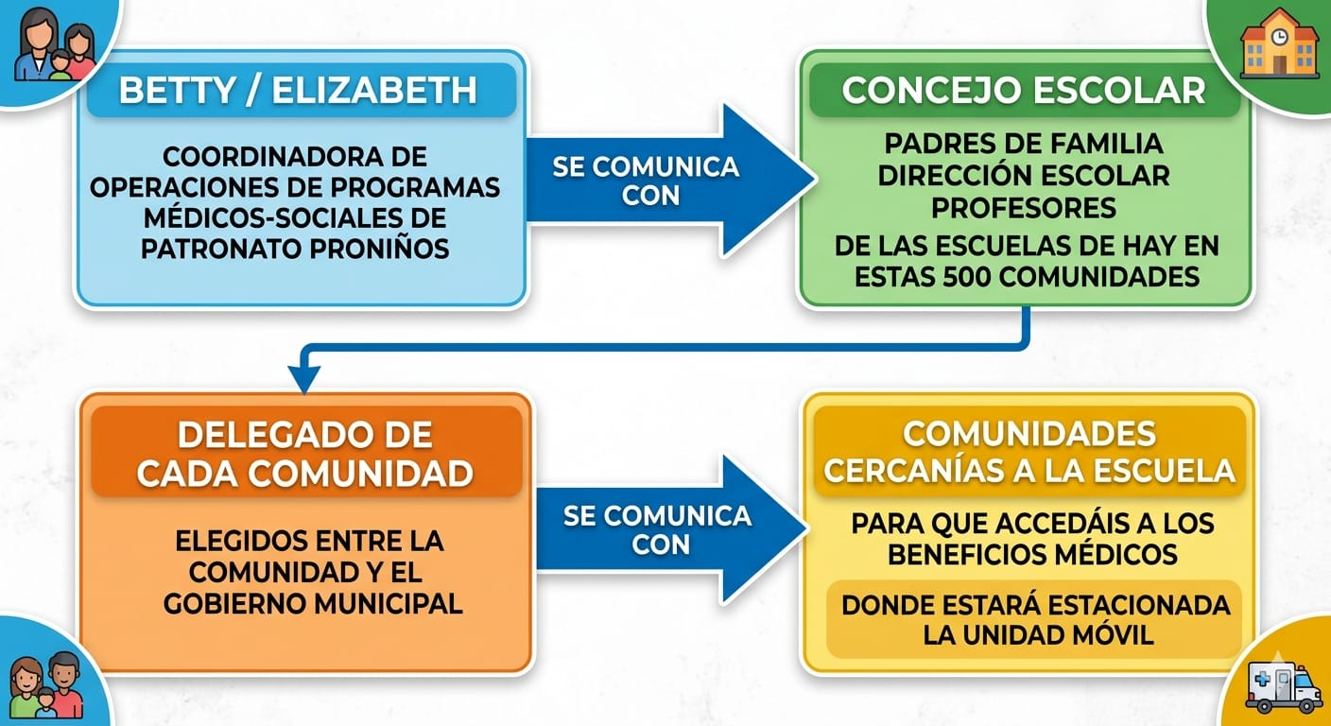

Slide 61
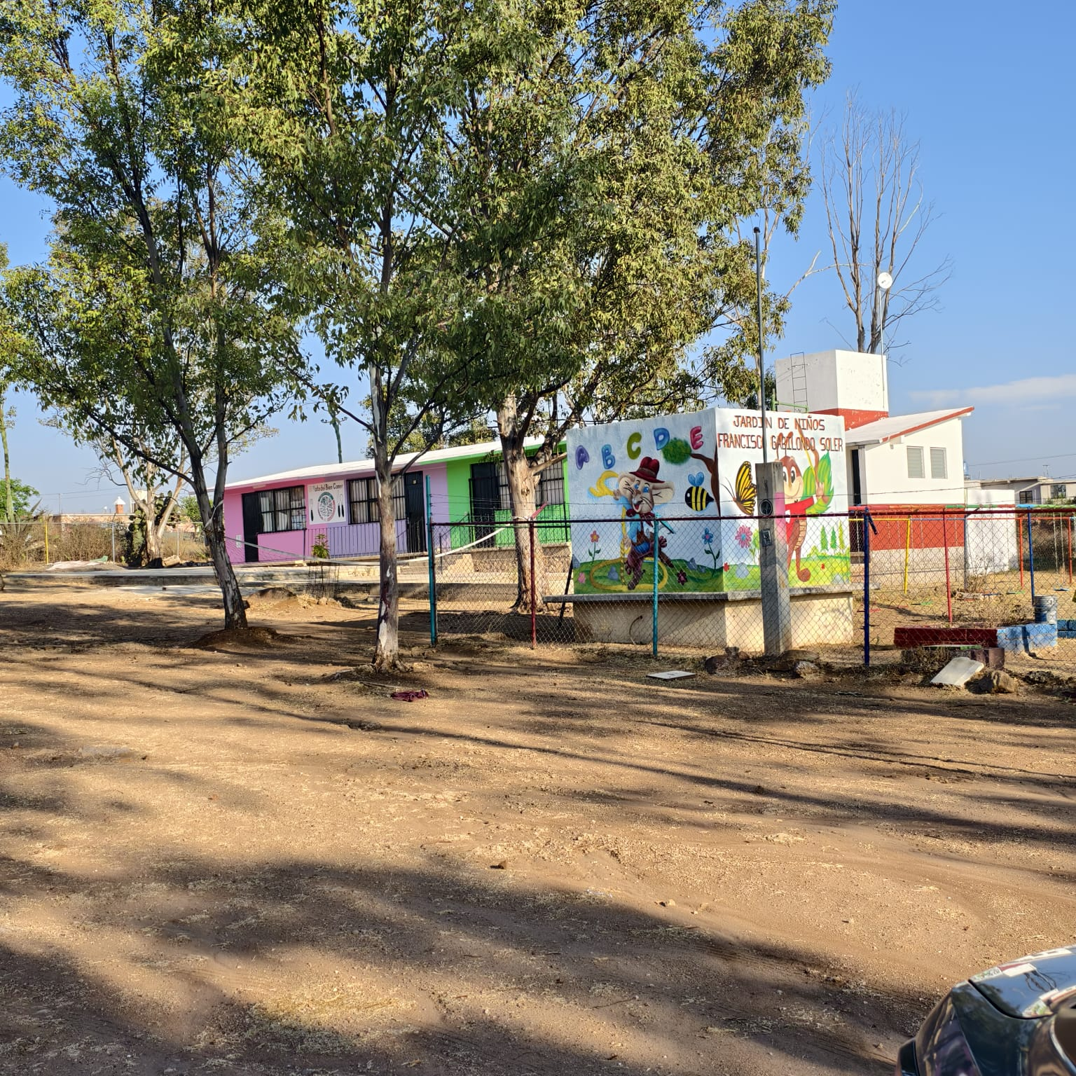
Lomas de la Purísima
Primary school & preschool, 70(47+23) students all togheter

Slide 62
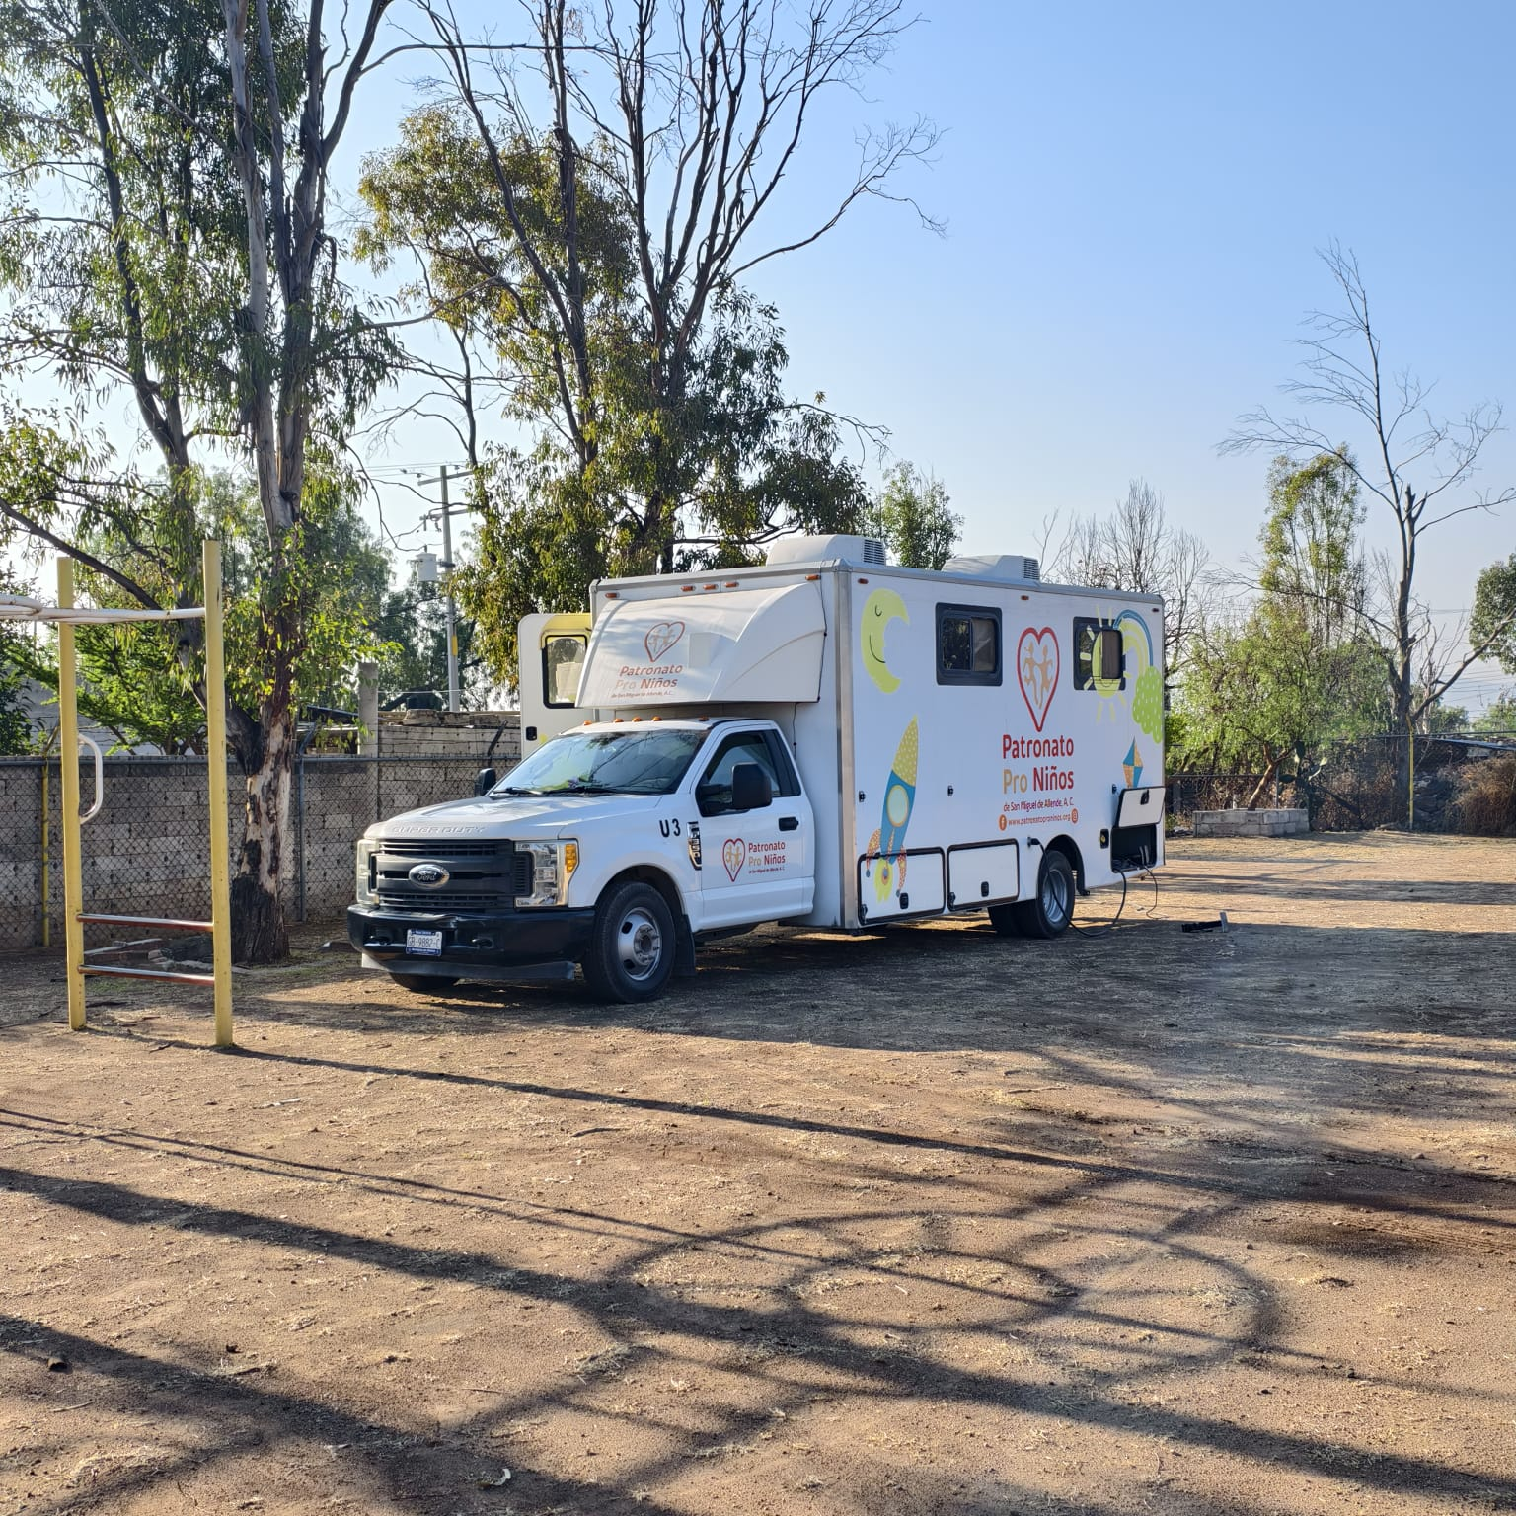

Slide 63
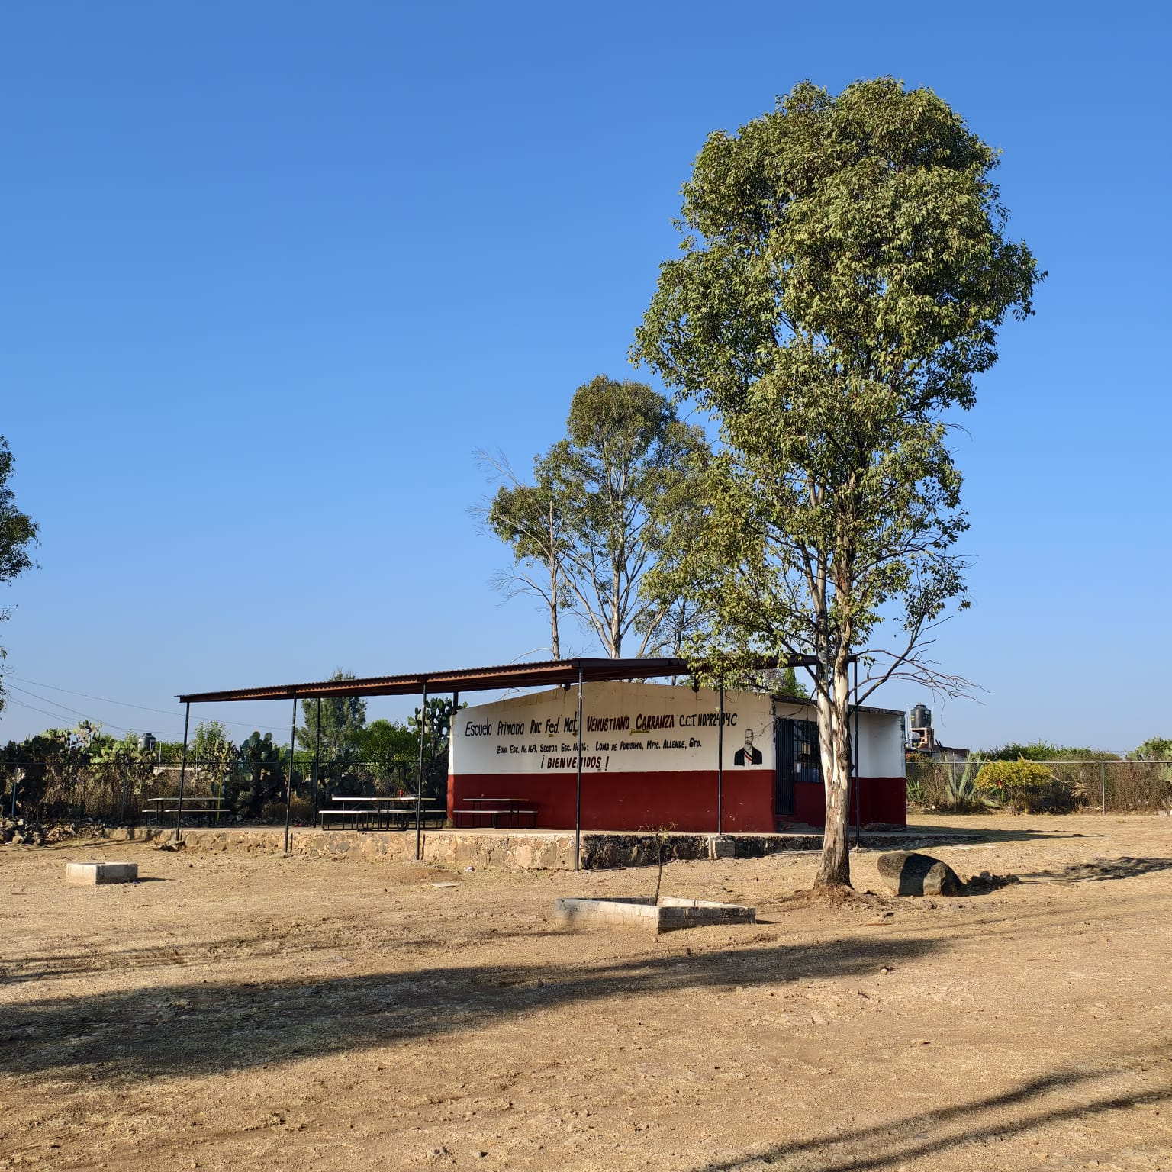

Slide 64
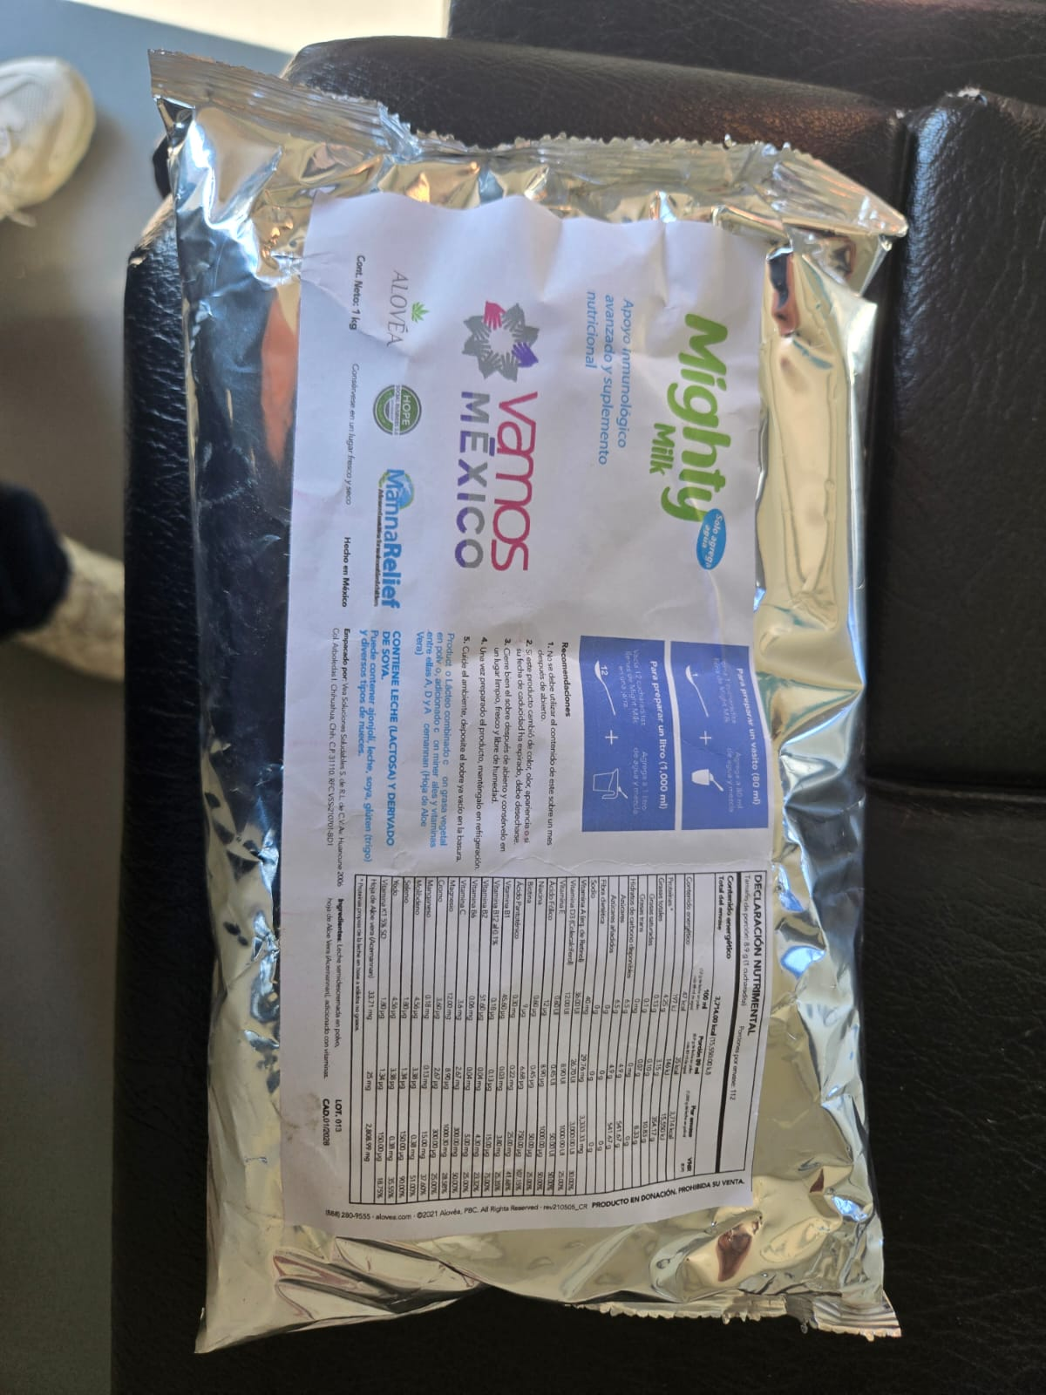
Nutritional package

Slide 65
Patronato Pro Niños – Annual Production
≈14,000 medical, dental, and psychological consultations per year
≈1000–1500 children served annually

Slide 66
Production per Mobile Unit (Estimated)
We have not yet received detailed data from Patronato, but according to preliminary estimates:
Total consultations: ~14,000 per year
Mobile units: 5
≈2,500–3,000 consultations per unit per year
≈200–250 consultations per month
≈10–20 patients per day per unit

Slide 67
Coverage of Communities
San Miguel municipality has 500+ rural communities
Programs typically operate in 30–50 communities per 3 years
Example: 10-17 communities visited in one dental program year

Slide 68
Strategic Implications & Conclusion
Patronato’s existing NGO infrastructure already covers a limited number of communities.
• Partnerships may provide a faster and more sustainable impact than building a completely separate structure from the beginning.
• Adding stationary dental teams to Patronato’s existing resources in geographically strategic areas, together with a modified working model, could complement the current system and significantly expand coverage to underserved communities.
• This approach could potentially increase child coverage by up to fivefold, with approximately double the annual operational cost, combined with a one-time investment for establishing the clinic infrastructure.

Slide 69
Example NGO Budget
Patronato Pro Niños ~6-7Million pesos/year (~350000 USD)

Slide 70
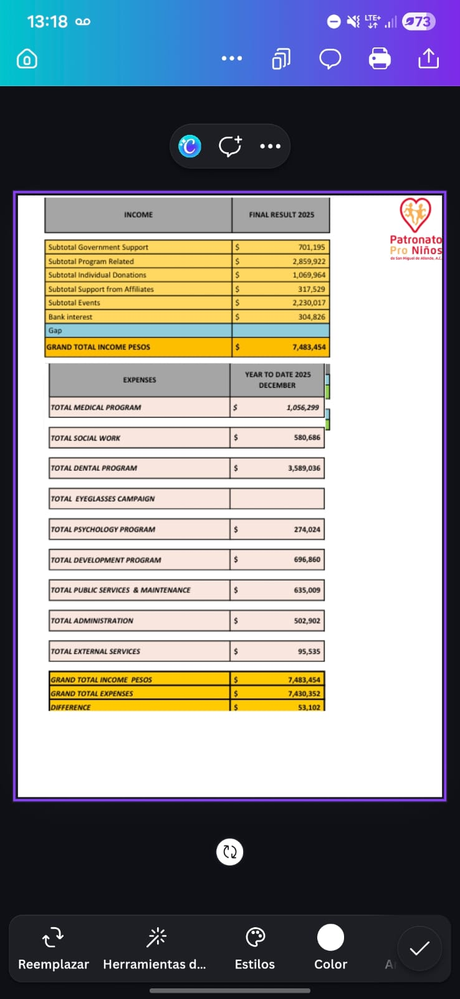
Priliminary budget ?

Slide 71

Casa Hogar Mexiquito
Current Situation
Planning basis for possible initial collaboration focused on children’s safety, care environment, education and welfare
Centro de Asistencia Social • 21 April 2026
Source: Visit Report and additional information – Santuario Hogar Guadalupano / Casa Hogar Mexiquito
1

Slide 72
Overall Observations
Human commitment is strong; the physical environment remains simple and resource-constrained
Strengths observed
Environment
Daily life
Strong human commitment, attentive care, respectful interaction, and a clear intention to create a safe environment.
Functional but simple; institutional in character, with limited light, color, and homelike atmosphere.
Children were observed as active, social, engaged in play, and appearing safe within the environment.
Planning implication
Early support should prioritize safety, dignity, lighting, functionality and learning conditions.
Interventions should remain practical, measurable and within the limits of available budget.
Collaboration should reinforce the existing care model rather than replace local structures.
Source: Visit Report and additional information – Santuario Hogar Guadalupano / Casa Hogar Mexiquito
2

Slide 73
Capacity and Current Operations
Casa Hogar functions as a residential care setting for children placed by authorities
24
10
14
$100
Approximate physical capacity / places
Current residents: children and adolescents
Realistic capacity with current resources
MXN per child per day recovery fee
Admission pathway and operational model
Children are admitted through DIF, Procuradurías and Fiscalía authorities.
The model separates living, education, technology and activity spaces to support safety, supervision, rest and recovery.
No direct family contact is part of the current model, except when arranged by the competent authorities.
Source: Visit Report and additional information – Santuario Hogar Guadalupano / Casa Hogar Mexiquito
3

Slide 74
Facilities and Physical Environment
Main functional areas and observed infrastructure conditions
Dining and kitchen
Dormitories
Outdoor area
Dining room capacity around 30 people. Shared meals with children, staff and volunteers. Kitchen directly connected.
Several dormitories with around 6–8 beds per room. Separate areas for age groups: 2–5, 6–10, and 11–15 years.
Interior courtyard with concrete surfaces. Former pool is currently used as play area and football field.
Current environmental needs
Several spaces are perceived as dark with limited lighting.
There are few homelike elements and limited color in the environment.
Recreational spaces are used daily and reported as highly utilized.
Source: Visit Report and additional information – Santuario Hogar Guadalupano / Casa Hogar Mexiquito
4

Slide 75
Safety and Technical Systems
Planned and needed measures are linked to child safety and regulatory standards
Current observation
Planned measures
Regulatory context
Limited visible security equipment during the visit; perimeter and technical systems remain important areas for follow-up.
Automated main gate, central control from reception, six surveillance cameras and reinforced perimeter security.
Compliance requirements include PEPNNA, Civil Protection and COFEPRIS-related standards for safety, hygiene and operations.
Practical implications for collaboration
Any security or electrical intervention should be preceded by local technical assessment and budget quotation.
Minor repairs may be suitable for an initial collaboration if they can be completed safely and quickly.
Larger interventions should be separated into phased projects with clear responsibility and maintenance plans.
Source: Visit Report and additional information – Santuario Hogar Guadalupano / Casa Hogar Mexiquito
5

Slide 76
Identified Priority Needs by Managment
Needs reported by the organization and confirmed in the visit material
Infrastructure
Security
Energy
Classrooms, drainage, showers, dormitory painting, lighting
Camera system, electrical fence maintenance, automated entrance
Solar panels and energy-efficiency considerations
Operations
Education
Care quality
Laundry equipment, kitchen utensils, office furniture and equipment
Computer room upgrade; most existing computers are obsolete
Sala de Acogida for reception, crisis management and psychological support
Priority should be based on child safety, regulatory compliance, educational value, feasibility and available budget.
Source: Visit Report and additional information – Santuario Hogar Guadalupano / Casa Hogar Mexiquito
6

Slide 77
Sala de Acogida
A planned reception and emotional stabilization unit — not a standard room
Purpose
Current status
Initial reception of new children
Crisis management and containment
Individual psychological interventions
Interviews and multidisciplinary assessment
Project defined but not yet constructed
Architectural plans and construction budget exist
Current reception is handled within the existing psychological consultation room
Why this matters
In trauma-informed care, the first contact and emotional stabilization can influence the child’s future rehabilitation process. This makes the unit strategically important, but likely more suitable for a separate phased project.
Source: Visit Report and additional information – Santuario Hogar Guadalupano / Casa Hogar Mexiquito
7

Slide 78
Possible Initial Collaboration Areas
Limited, concrete interventions within available budget and after local technical validation
Drainage
Security fence
Computers
Repair drainage problem in teenagers’ bathrooms
Improve damaged electrical security fence if only minor work is required
Purchase 3–4 modern desktop computers for children’s education
TV room
Dormitories
Lighting
Install a larger TV for the children’s TV room
Assess air-conditioning / heat pump solution for children’s and teenagers’ dormitories
Improve lighting in selected outdoor areas and parts of the bedrooms
All items should be prioritized according to safety, urgency, feasibility, local quotations and the project budget.
Source: Visit Report and additional information – Santuario Hogar Guadalupano / Casa Hogar Mexiquito
9

Slide 79
Proposed Next Steps
A cautious stepwise approach for realistic and transparent implementation
1
2
3
4
Confirm priorities
Technical assessment
Budget decision
Implementation plan
Validate the most urgent needs with Casa Hogar leadership.
Obtain local inspection and written quotations for each intervention.
Match proposed activities with available funding and administrative feasibility.
Define timeline, responsible persons, documentation, and follow-up.
The initial collaboration should start with small, well-defined actions and avoid large commitments before technical, financial and administrative clarity is achieved.
Source: Visit Report and additional information – Santuario Hogar Guadalupano / Casa Hogar Mexiquito
10

Slide 80
Key Implication for Health Initiatives for fundacion nur
Effective programs often combine:
Stabilize mobile outreach services and connect them to central clinics
• Partnerships with local NGOs would be optimal but it has not be possible yet.
• Preventive care and education
• Support for transportation and medications

Slide 81
Fundacion Nur’s Role as a NGO
Organizations like Patronato Pro Niños, but with a modified working model, help bridge healthcare gaps through:
• Strengthening existing public healthcare services, including both stationary and mobile clinics, as well as other NGO clinics,
• Digitalization of social and medical records, as well as improvement of the approach to chronic diseases and coverage of certain essential medications that are currently lacking within the healthcare system
• Utilizing existing social networks and community-based support systems
• School-based care
• Preventive programs
• Pilot projects in areas with moderate psychosocial and security-related challenges
• Support for vulnerable families through financial counseling and other social interventions, collaboration with other NGO:s such as Casa Hogar Mexiquito, or NGO for assistance with water sanitation and basic community infrastructure

Slide 82
Strategic Conclusion
Clinic + outreach + diagnostics + affordable medicines
Medication Procurement:
International NGO wholesalers can reduce cost x 2–5

Slide 83
Additional needs/ service private
Hub clinic + mobile outreach teams
Additional service:
Laboratory Setup
Startup ~ 7000-15000USD
Tests: CBC, glucose, HbA1c, CRP, urinalysis
Radiology Access in Private
X‑ray 20–70 USD
Ultrasound 50–100 USD
CT 200–400 USD
MRI 400–700 USD

Slide 84
NGO stationary/mobile dental Clinic estimated Cost
Stationary:
120,000 USD(a part of Salud location)-180,000 USD(half mobile buss-station/ container) investment (2 units ,one advanced one middle class in same clinic with electronic X-ray+ (35-40% material, personal, maintenance/ year)
Capacity ~5000-6500– treatment/year
Mobile:
60,000 USD investment( 2 simple unit inkluderande vehicle)+ (40-50% material, personal, maintenance)
Capacity ~10 000-13 000– screening /year

Slide 85
Clusters of Vulnerable Communities
Puerto de Nieto
Los Rodríguez
Corral de Piedra
Jalpa region
Banda region
La Cieneguita
Alcocer

Slide 86
Optimal Location for New dental Health Center
Central to several communities
Reduces travel time for rural population
Corralejo which may cover
Los Rodríguez
Corral de Piedra
Puerto de Nieto corridor

Slide 87
Conceptual Map – San Miguel de Allende
Los Rodríguez
Corralejo (proposed dental clinic)
Corral de Piedra
Puerto de Nieto

Slide 88
Relevant links
https://sufiservice.org/
https://sufiservice.org/our-work/
https://sufiservice.org/cote-divoire/
https://fdjn.ngo/
https://youtu.be/cROqKqkNONE
https://www.facebook.com/FoundationNur/
https://www.folketsvardcentral.se/
----------------------------------------------------------------------
https://www.patronatoproninos.org/
https://casa.org.mx/en/
https://difsanmigueldeallende.gob.mx/

